Slide 1

CIS 508: Team 344 Group Presentation
Kevin Xiong
Vishesh Rai
Eva Hsu
Snigdha Pilli
Janice Lai
Vijay Kumar Devalla

Slide 2
Business Overview
Focus: Utilizing detailed customer data to track account status—active or closed.
Impact: Customer churn leads to direct revenue loss, increased acquisition costs, and reduced profitability.
Significance: Addressing account closures (churn) is a crucial challenge for sustained growth and competitiveness in the financial industry.
Approach: Strategically leveraging insights to proactively manage churn, strengthen relationships, and optimize revenue.

Slide 3
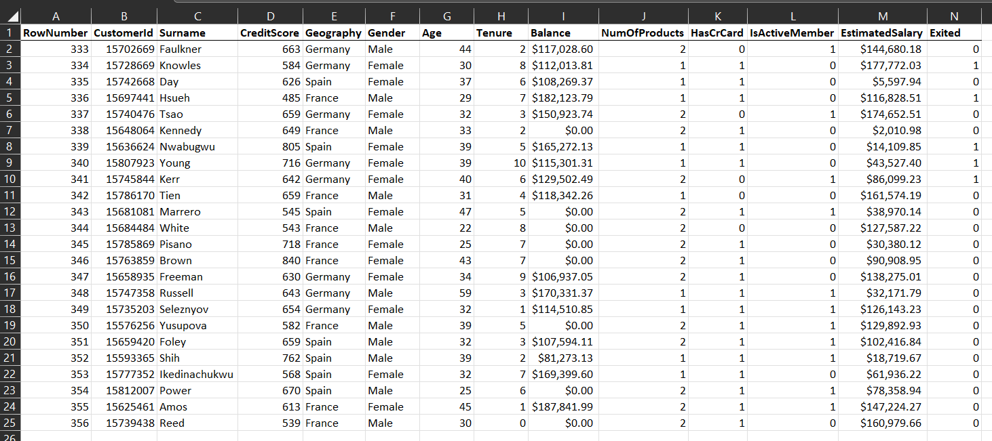
Dataset
Our dataset contains
Binary target variable
Numerical and Categorial feature variables

Slide 4
Data Choice
01 CreditScore
02 Geography
03 Age
04 Tenure
05 Balance
06 NumOfProducts
07 HasCrCard
08 IsActiveMember
09 EstimatedSalary
This data set contains 10,000 rows data.
Why certain variables are removed?
01 RowNumber
02 CustomerID
03 Surname
04 Gender

Slide 5
Data Choice
RowNumber: This is likely a sequential identifier for each row in your dataset. It does not carry any meaningful information about the customer's behavior or characteristics that would influence their decision to leave the bank.
CustomerID: Similar to RowNumber, CustomerID is a unique identifier for each customer.
Surname: The surname of a customer is another variable that does not have a direct impact on their banking behavior or their decision to stay with or leave the bank.
Gender: Based on bias and ethical considerations, the inclusion of gender as a variable can potentially lead to biased outcomes. Moreover, our goal is to understand and predict churn based on financial behaviors and product usage, gender might not be relevant to this specific analysis.

Slide 6


Data Preparation

Slide 7
Over Sampling
Label Encoding
Observed that target variable has unequal distribution of 0s and 1s
Used Synthetic Minority Over-sampling Technique (SMOTE) to balance the distribution of target variable
Categorical values need to be encoded into numerical values.
Created dummies for ‘Geography’
Changed ‘Balance’ and ‘Estimated Salary’ columns from string to numerical values

Slide 8
Null Handling
Column Dropping
To prevent inaccurate model training, we need to address the missing values.
Used mode to fill in the missing data
Remove unwanted columns to build an efficient model.
These columns have minimal to negligible effect on the target variable.

Slide 9

Modeling Overview
Models Implemented:
We implemented a diverse set of models, including:
Decision Tree, Logistic Regression,
SVM, Neural Networks, Random Forest, Ensemble Models, Gradient Boosting, XGBoost, and K-NN.
Each model brings a unique approach to tackling the challenge of predicting bank churn.

Slide 10
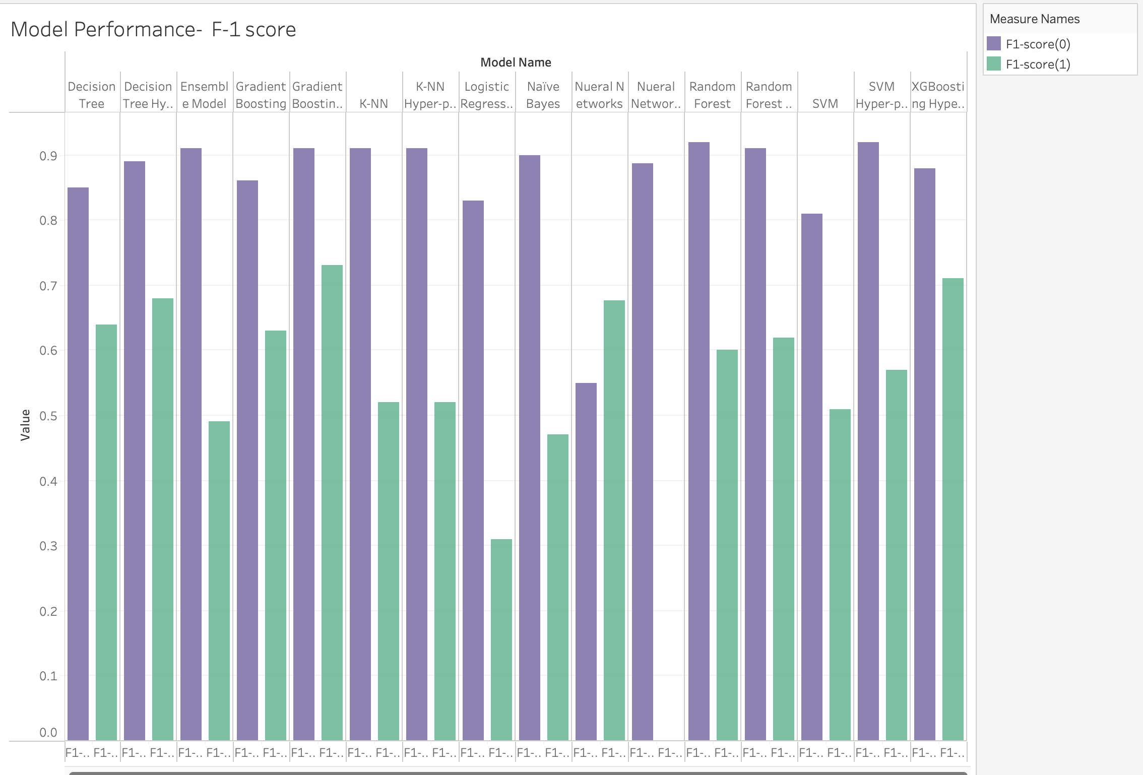
Model Performance Comparison:
F-1 score:

Slide 11
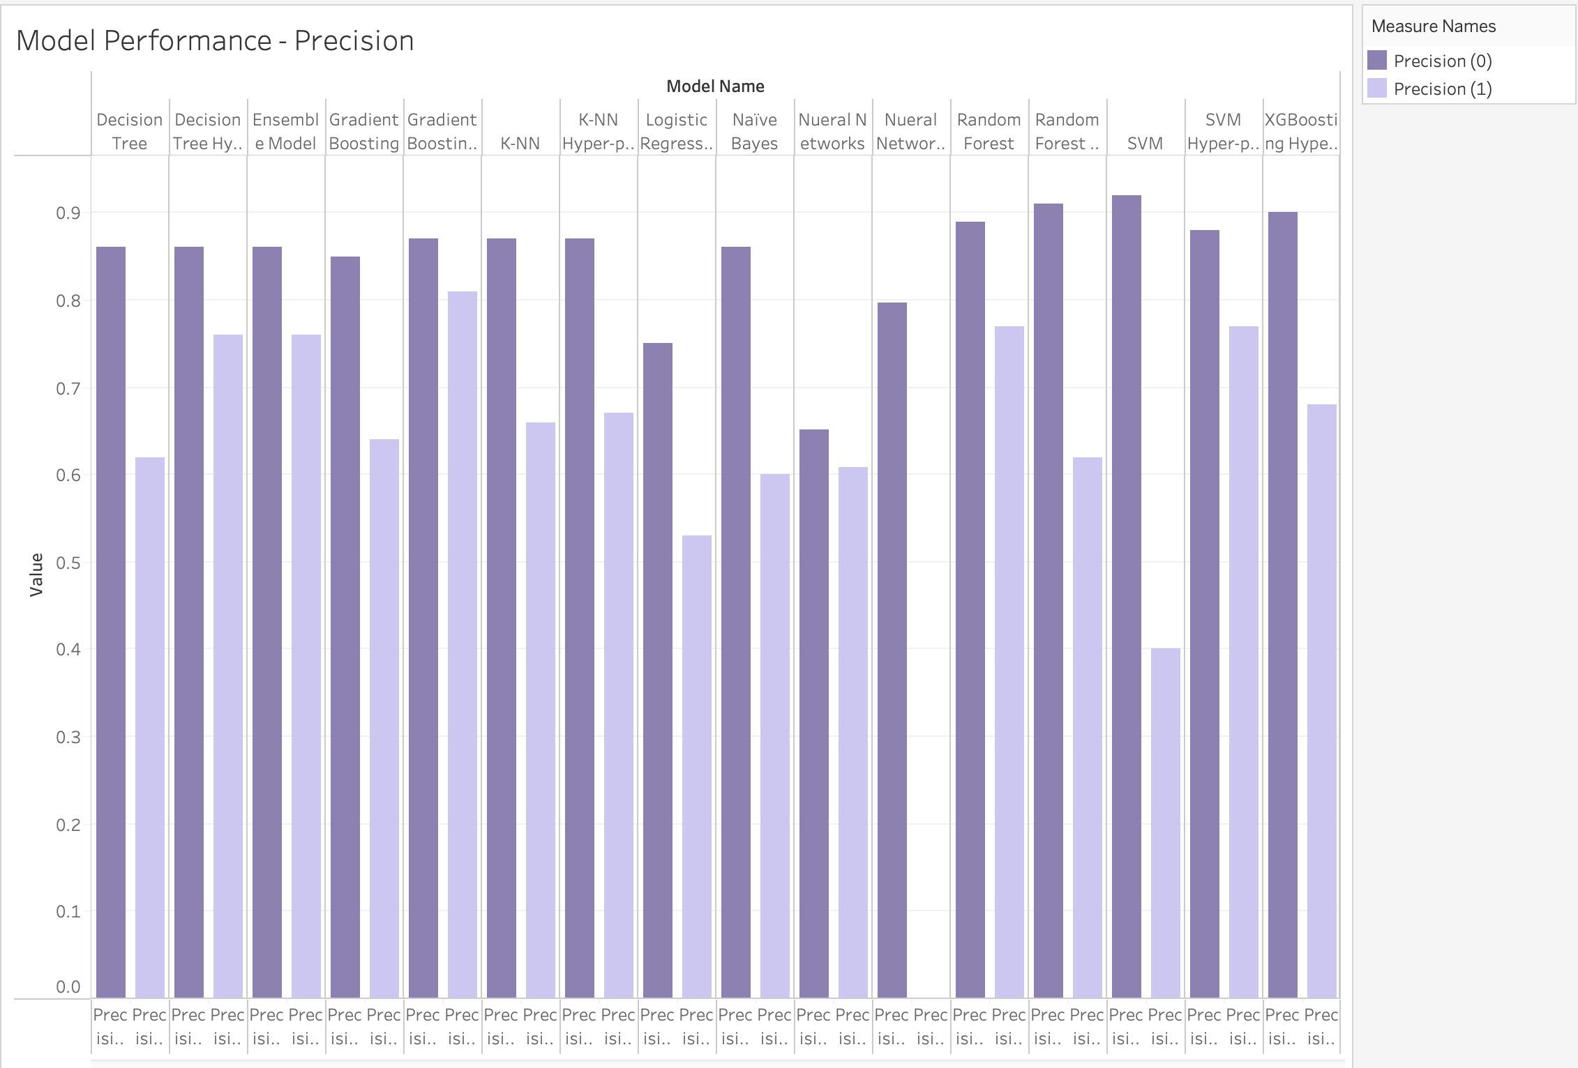
Precision Comparison:
Precision:

Slide 12
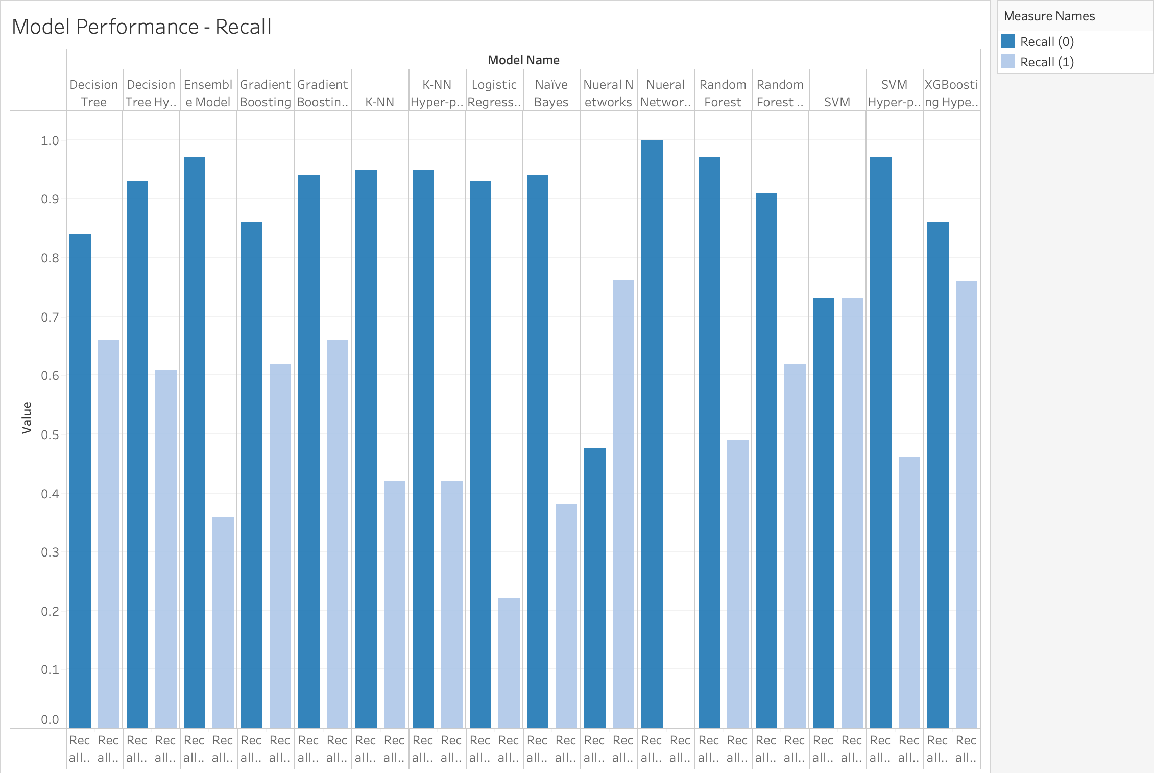
Recall Comparison:
Recall:

Slide 13

Analysis of Specific Models
K-Means Clustering:
K-Means Clustering, an unsupervised algorithm, employs metrics like Silhouette Score (0.21) and Inertia (34999.87) for evaluation. The moderate Silhouette Score suggests some separation between clusters, urging careful examination for meaningful insights amid potential overlap. Inertia signifies cluster compactness, with ongoing exploration involving adjustments to cluster numbers to enhance distinct and meaningful groupings in our project.
Logistic Regression Attribute Selection:
In the realm of Logistic Regression attribute selection, the focus is not solely on traditional metrics. Instead, we emphasize the importance of feature selection and the impact of variables on the model. A careful analysis of coefficients and statistical significance guides us in understanding the relevance of each attribute in predicting customer churn.

Slide 14

Winning Model: Gradient Boosting Hyper-parameter Tuning
The standout model is Gradient Boosting with Hyperparameter Tuning, as evidenced by its strong performance metrics in precision, recall, and F1-score for both class 0 and class 1.
This noteworthy achievement suggests that the Gradient Boosting model minimizes false predictions effectively for both categories, reinforcing its reliability and accuracy in our predictive modeling context.

Slide 15

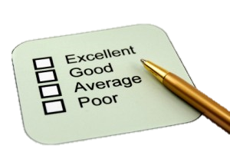
Model Evaluation

Slide 16

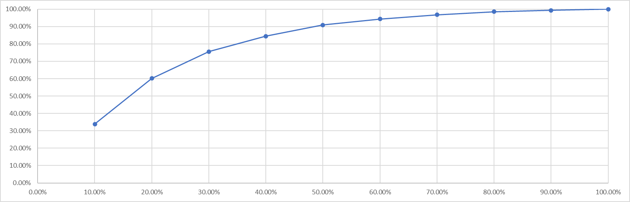
Evaluation: Lift/Gain Curve
By reaching out to 40% of the customers who belong to 4 deciles, we will be able to find out 85% of the customers who are more likely to exit.
A Lift of 2, for example, corresponds with there being twice the number of customers exited compared with the number you’d expect by contacting the same number of customers at random.
So, we may have only contacted 40% of the customers, but we may have reached 85% of the customers who are likely to exit in the customer base.

Slide 17

Evaluation: Business Case Development Steps for Project Improvement.
Define the business problem:
- High customer churn rates impacting revenue and profitability.
Current State:
- Describe the current situation: Current churn rates, associated costs, and the impact on customer satisfaction.
- Highlight the need for a proactive approach to customer retention.
Expected Improvements:
- Quantify the expected improvements:
- Reduce churn rate by X%.
- Increase customer retention by X months.
- Enhance customer satisfaction and loyalty.
ROI Projection:
- Calculate ROI by considering:
- Cost of implementing the churn modeling solution.
- Projected revenue increase from retained customers.
- Potential cost savings in marketing efforts targeting the right customers.
Key Metrics for Evaluation:
- Identify key performance indicators (KPIs) for evaluating the success of the churn modeling solution:
- Precision, recall, and F1 score for model accuracy.
- Reduction in customer churn rate.
- Increase in customer lifetime value (CLV).

Slide 18

Evaluation: Suggesting Improvements
Feature Importance Analysis:
- Conduct a feature importance analysis to understand which factors contribute most to churn predictions. Use this information to suggest improvements in customer retention strategies.
Explore Advanced Techniques:
- Consider exploring more advanced modeling techniques (e.g., ensemble methods, deep learning) to potentially enhance the predictive capabilities of the model.
Continuous Monitoring and Iteration:
- Emphasize the importance of continuous model monitoring and iteration. Churn patterns may change over time, and the model should be adapted accordingly.
Customer Segmentation:
- Explore customer segmentation to tailor retention strategies for different customer groups. This can enhance the precision of targeted interventions.

Slide 19

Deployment strategies

Slide 20

Model Deployment
For less time-sensitive use cases, deploy the model in a batch processing pipeline that periodically evaluates churn risk for all customers.
Implement an alerting system that notifies relevant stakeholders when a high-risk customer is predicted, allowing for proactive retention strategies.
Establish a feedback loop where model predictions and outcomes are monitored, and the model is periodically retrained for continuous improvement.
Develop a monitoring dashboard that provides insights into model performance, prediction accuracy, and customer churn trends.
Ensure the model's predictions are interpretable, especially if customer-facing staff will use them, to build trust in the model's recommendations.

Slide 21

Thanks

